Slide 1
KILIMO TEXT
By Digital Farmers

Slide 2
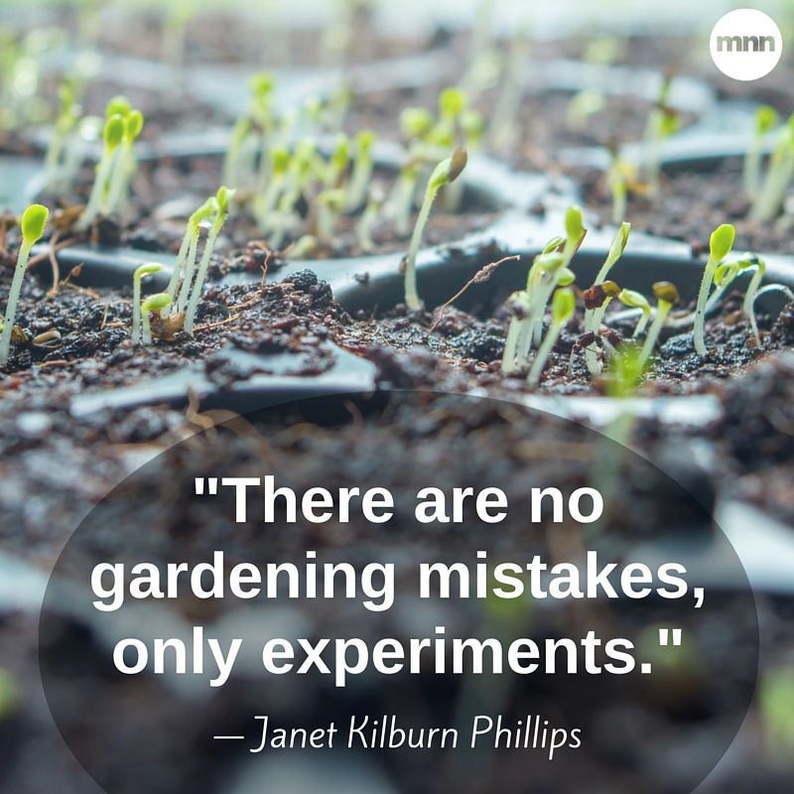

Slide 3
Meet Digital farmers who are aiming at:
Automating agriculture activities for better crop production and increase farmers economy by using SMS in telephone.
Kilimo text is ideas for saving farmers time and makes green houses farming simple.

Slide 4
Problem statement
Poor monitoring of agricultural activities to green houses farmers who are located in urban areas undertaking middle scale farming.

Slide 5
What can be done
Controlling the farming system digitally by automating agricultural activities and linking the farmer and his or her farm through normal SMS text. Those targeted activities are:
Irrigation.
Spraying pesticides.
Determining soil moisture.
Determining soil temperature.
Determining soil PH.

Slide 6
Product validity

Slide 7
Revenue model
Selling and installation of the system to customers
Maintenance of the system when problem happen.
Payments will be done in different instalments to make the product affordable to customers

Slide 8
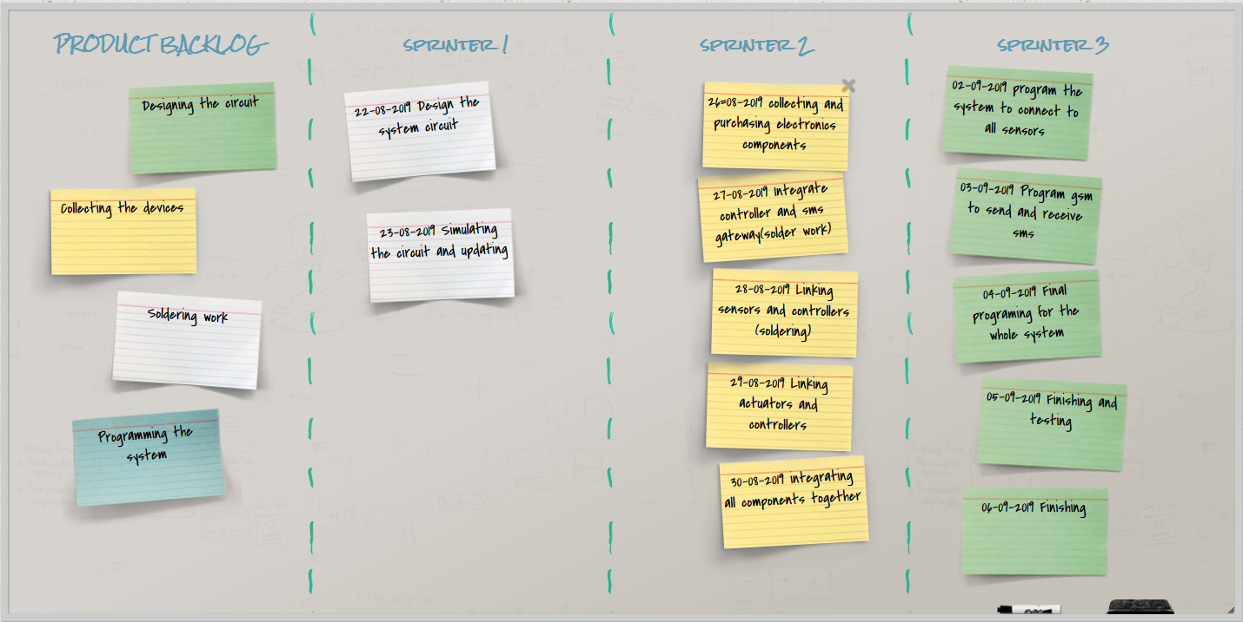
Milestone

Slide 9
Marketing strategies
Product promotion through
Exhibition
Seminars
Social medias

Slide 10
INVESTIMENT AND FUND
Money for buying materials
We need money for production
Money for advertisements

Slide 11
COMPETITIVE ADVANTAGES
We are providing our services through making farmer communicates to his farm using telephone from far by giving the present condition of a farm by determining soil PH, soil moisture, soil temperature.
So farmer can perform his duties to his farm without being there and every task in a farm can be done.

Slide 12
Team
NAME | ROLE
BEATRICE MIKE | DEVELOPER
KALEBU GWALUGANO | IMPLEMENTOR
MOHMED MUSSA | TEAM LEADER
WILBROAD NYIRENDA | SPECIALIST

